Slide 1



Towards Efficient Serving of
Network-intensive LLM Inferences
Weiye Wang, Chen Chen, Junxue Zhang
Zhusheng Wang, Hui Yuan, Zixuan Guan, Xiaolong Zheng
Qizhen Weng, Yin Chen, Minyi Guo

Slide 2
Background: LLM Inference and Service Objectives
LLM Inference includes two different phases:
  Prefill: processes the prompt tokens to obtain KVCache, related to TTFT.
  Decode: generates tokens one by one, related to TBT.
Prefill
Decode
Iteration 1
Iteration 2
…
Long financial report
KVCache
The
KVCache
Cloud
Which segment was most profitable?
Time to First Token (TTFT)
Time between tokens (TBT)

Slide 3
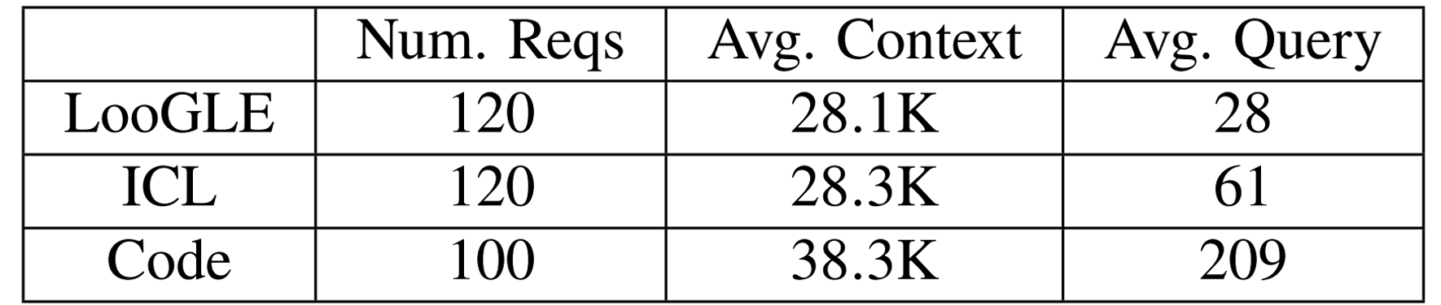
Background: Long Context Workload and KVCache Reuse
LLM inference workloads are evolving toward “long context, short query”.
Prefix KVCache can be reused to reduce prefill computation.
Typical “long context, short query” workloads.
Which segment was most profitable?
Context
Query
Which segment generated the most revenue?
Context
Query
Financial Report
with 90K+ Tokens
Reusable shared long context
User Query with only
10-300 tokens

Slide 4


Background: KVCache in Distributed Storage Pool
To broaden storage space, distributed storage pool is widely used.
  Need to load KVCache to GPU before computation starts.
Resources needed by each stage:
  𝐿3→𝐿2 Load: Network Bandwidth.
  𝐿2→𝐿1 Load: PCIe Bandwidth.
  Computation: GPU SMs.
Context
Query
KV
KV
KV
KV
L3: Distributed KV Pool
L2: CPU DRAM
L1: GPU VRAM
Via Network
Via PCIe
KV
KV
KV
KV

Slide 5
Background: KVCache in Distributed Storage Pool
To broaden storage space, distributed storage pool is widely used.
  Need to load KVCache to GPU before computation starts.
Resources needed by each stage:
  𝐿3→𝐿2 Load: Network Bandwidth.
  𝐿2→𝐿1 Load: PCIe Bandwidth.
  Computation: GPU SMs.
Context
Query
KV
KV
KV
KV
L3: Distributed KV Pool
L2: CPU DRAM
L1: GPU VRAM
Via Network
Via PCIe
KV
KV
KV
KV

Slide 6
Background: KVCache in Distributed Storage Pool
To broaden storage space, distributed storage pool is widely used.
  Need to load KVCache to GPU before computation starts.
Resources needed by each stage:
  𝐿3→𝐿2 Load: Network Bandwidth.
  𝐿2→𝐿1 Load: PCIe Bandwidth.
  Computation: GPU SMs.
Context
Query
KV
KV
KV
KV
L3: Distributed KV Pool
L2: CPU DRAM
L1: GPU VRAM
Via Network
Via PCIe
KV
KV
KV
KV

Slide 7
Background: KVCache in Distributed Storage Pool
To broaden storage space, distributed storage pool is widely used.
  Need to load KVCache to GPU before computation starts.
Resources needed by each stage:
  𝐿3→𝐿2 Load: Network Bandwidth.
  𝐿2→𝐿1 Load: PCIe Bandwidth.
  Computation: GPU SMs.
Context
Query
KV
KV
KV
KV
L3: Distributed KV Pool
L2: CPU DRAM
L1: GPU VRAM
Via Network
Via PCIe
Compute
KV
KV
KV
KV

Slide 8
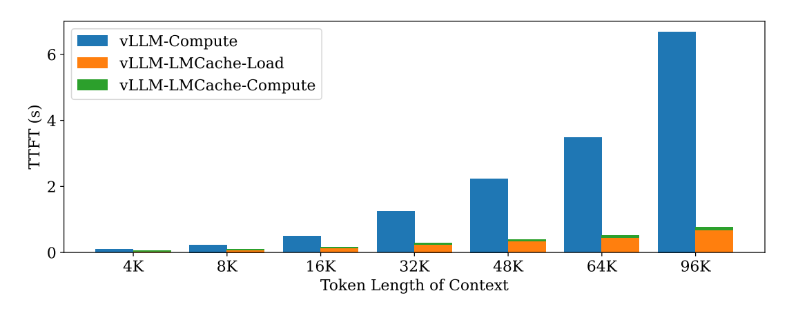
Emerging Bottleneck: KVCache Loading
Experiment Setup:
  We use vLLM, LMCache and Mooncake Store.
  400 Gbps network, fixed query tokens (1000), varying context lengths.
Result:
  KVCache loading accounts for up to 90% of TTFT, becoming the dominant factor in TTFT.

Slide 9
A Fundamental Mismatch in Current LLM Serving System
Workload Trend:
KVCache network transfer and prefill computation contribute comparably to TTFT.
Design:
Current LLM serving systems are designed to be compute-centric.
Mismatch
Consequence:
The mismatch between the compute-centric design of current LLM systems and the network-intensive nature of emerging inferences results in poor efficiency.

Slide 10
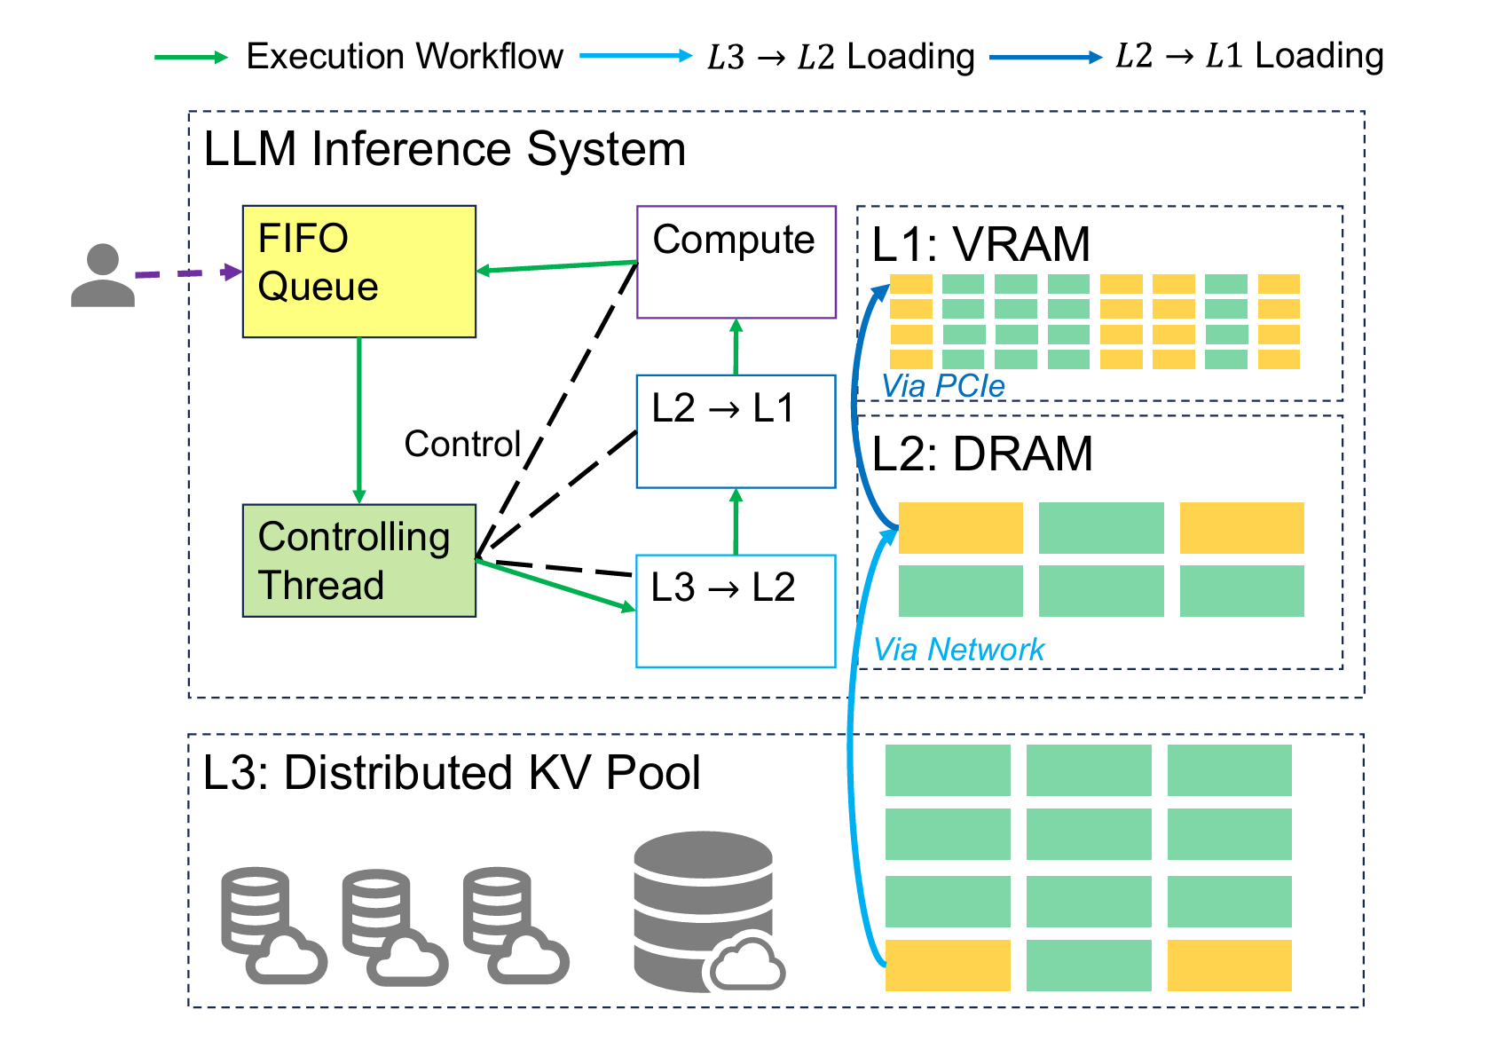
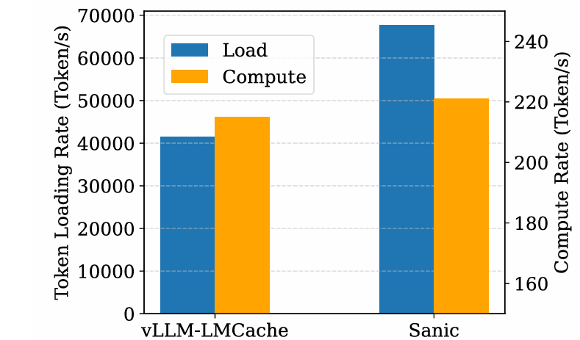
Problem 1: Low Concurrency in KVCache Loading
Current Practice:
  Adopt a centralized control model, where a single main thread orchestrates all stages.
  Each stage is passively triggered for execution.
Consequence:
  Low inter-stage pipeline execution concurrency.
  System resources are not fully utilized, resulting in low execution efficiency.

Slide 11
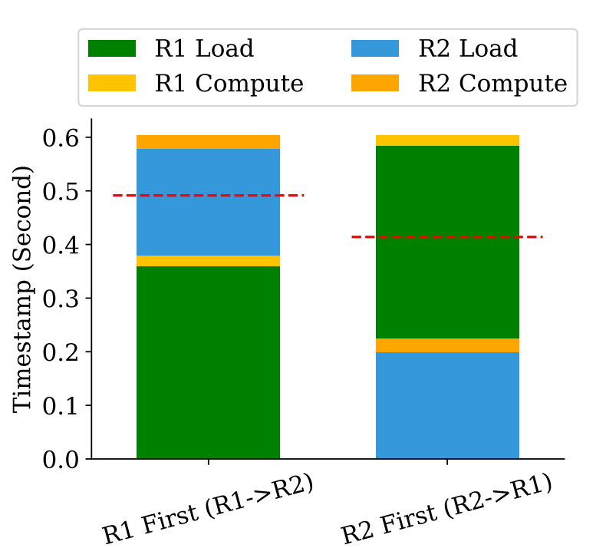
Problem 2: Scheduling Blindness to KVCache Loading Cost
Description:
  Concurrent inference requests compete for limited system resources and queue for scheduling in the inference engine.
  Existing engines are blind to KVCache loading cost, use FIFO or prioritize requests by estimated compute times.
Consequence:
  Compute-centric service-cost models fail to account for network transfer costs.
  Inaccurate cost estimations undermine quality of scheduling policy.
Request | Arrival | Loading | Compute
R1 | earlier | 0.361 s | 0.019 s
R2 | later | 0.199 s | 0.025 s
  Policy aware of KVCache loading cost would prioritize R2, significantly improving average TTFT.

Slide 12
Overview of Sanic
Key insight: treating KVCache network transfer as a first-class citizen, equally important to prefill computation.
Observation
Network-intensive LLM inferences are increasingly popular.
System Limitations
Low Resource Utilization
Low Scheduling Quality
Root causes
Centralized Control of Serving Workflow
Blindness to KVCache loading cost
Design Principles
Stage-Autonomous Execution
Network-cost-aware Scheduling
Proposed System
Sanic

Slide 13
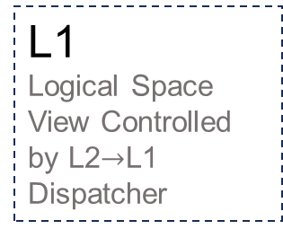
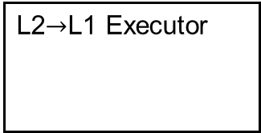
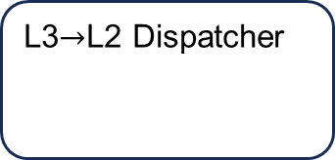
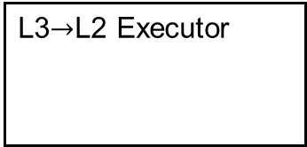
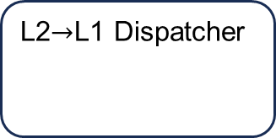

Design 1: Stage-Autonomous Execution
Stage-autonomous execution
  For each loading stage:
    Dispatcher: Allocate storage space.
    Executor: Perform loading operation.
  Autonomous executor keep loading when the following conditions are met:
    Source-layer KVCache data is ready.
    Target-layer KVCache space is allocated.
Autonomous Execution
Request Flow
L3$→$L2 Dispatcher
L2$→$L1 Dispatcher
R5
R4
R3
Compute Controller
R0
L3$→$L2 Executor
L2$→$L1 Executor
R3
R2
R2
R1
Benefits:
  Decouple 𝐿3→𝐿2 load, 𝐿2→𝐿1 load and compute.
  Keep network, PCIe, and GPU computation resources utilized.
L3
L2
Logical Space View Controlled by L3$→$L2 Dispatcher
L1
Logical Space View Controlled by L2$→$L1 Dispatcher

Slide 14
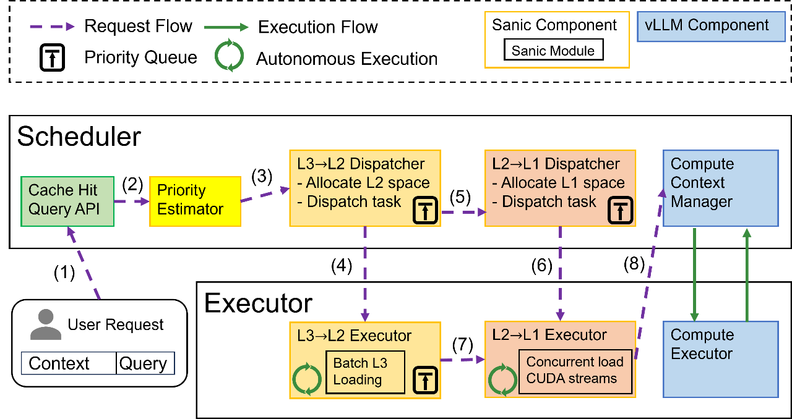
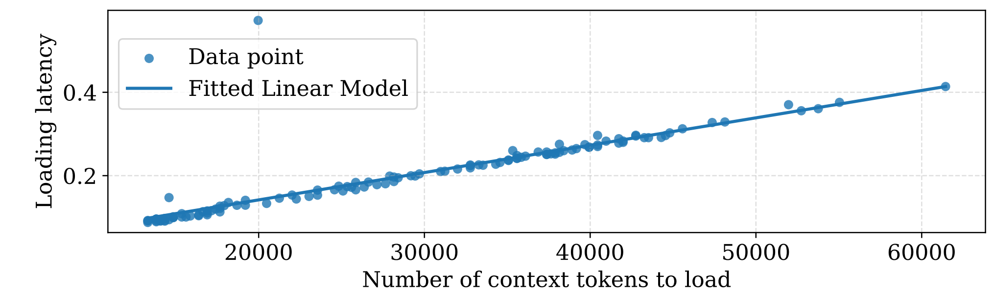
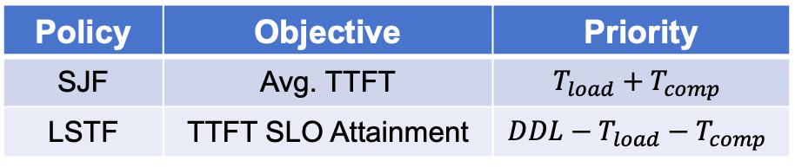
Design 2: Network-Cost-Aware Scheduling
Joint transfer-compute cost modeling
  Estimate prefill compute time with existing white-box method.
  Estimate loading time with a linear model.
Priority control across pipeline stages
  Queues of all dispatcher-executor pairs share same priority calculated by the policy.
  KVCache loading is prioritized for higher-priority requests.
Overview of Sanic.
Policy | Objective | Priority
SJF | Avg. TTFT | $$T_{load}+T_{comp}$$
LSTF | TTFT SLO Attainment | $$DDL−T_{load}−T_{comp}$$
Objective-specific network-cost-aware policies.
Predict KVCache loading time with linear model.

Slide 15


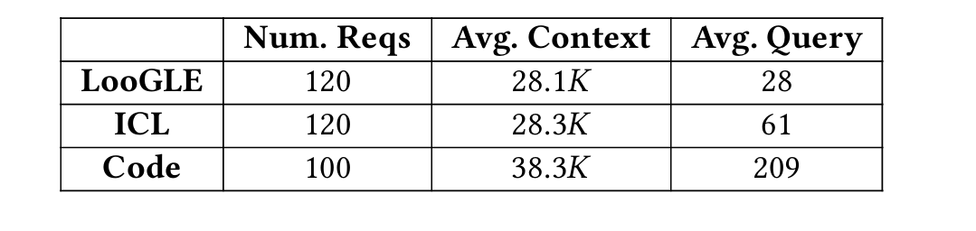


Evaluation: Experiment Settings
Sanic Implementation:
Built on vLLM (0.9.1) and LMCache (0.3.1).
L3 backend: Mooncake Store.
3.3K lines of code.
Testbed Settings
1$×$80GB GPU
128GB
DRAM
400Gbps RDMA Link
512GB
DRAM
Models:
Llama-3.1-8B-Instruct.
Qwen2.5-14B-Instruct-1M.
Workloads
Typical “long context, short query” workloads.

Slide 16
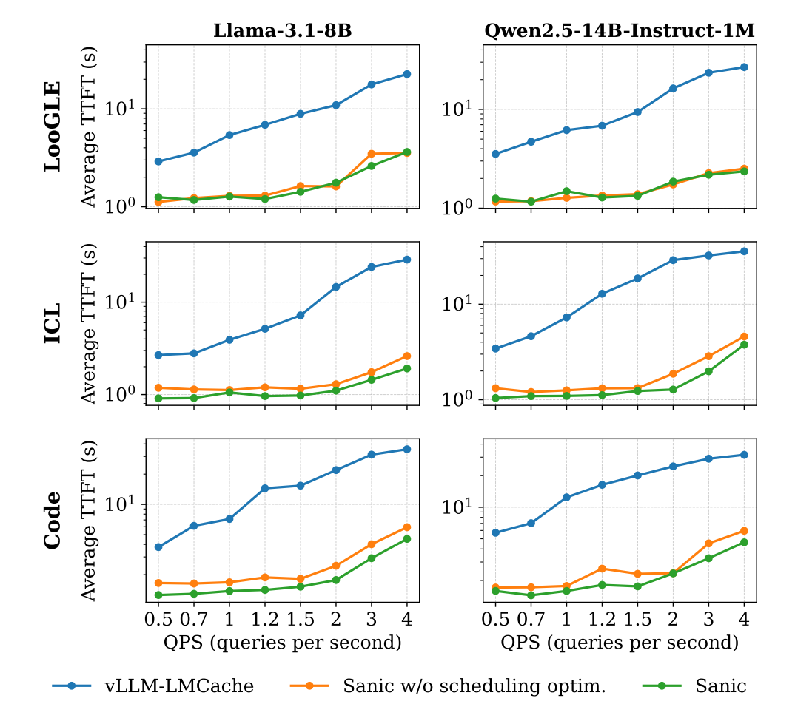
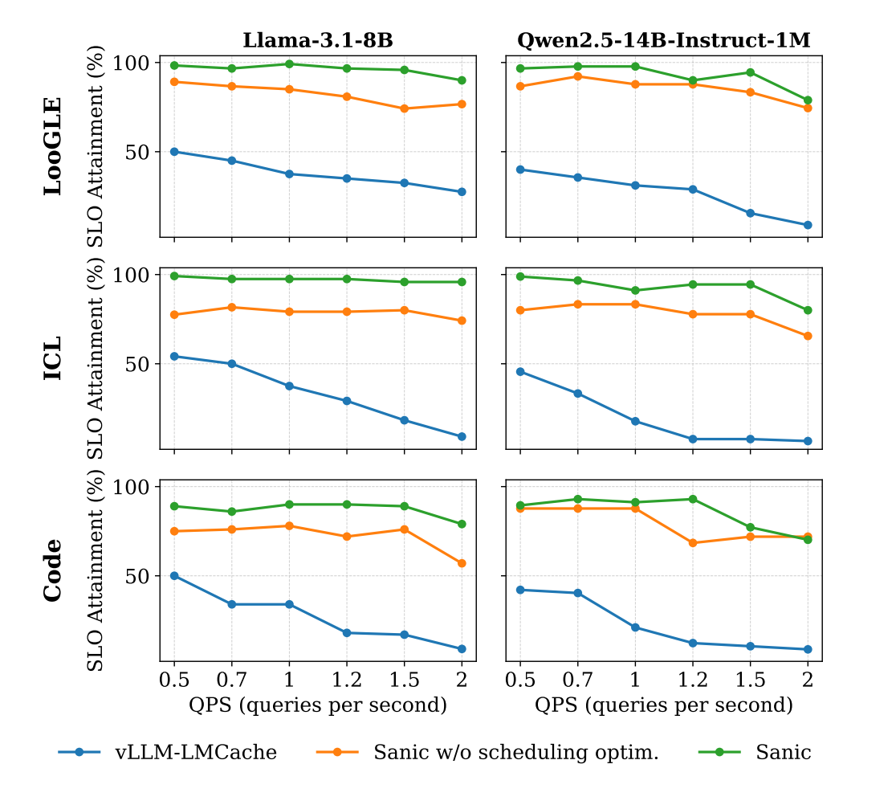
Evaluation: End-to-End Performance
Average TTFT Latency
TTFT SLO Attainment
Sanic can reduce the average TTFT by 81.3%.
Sanic can improve SLO attainment by 61.7%.

Slide 17
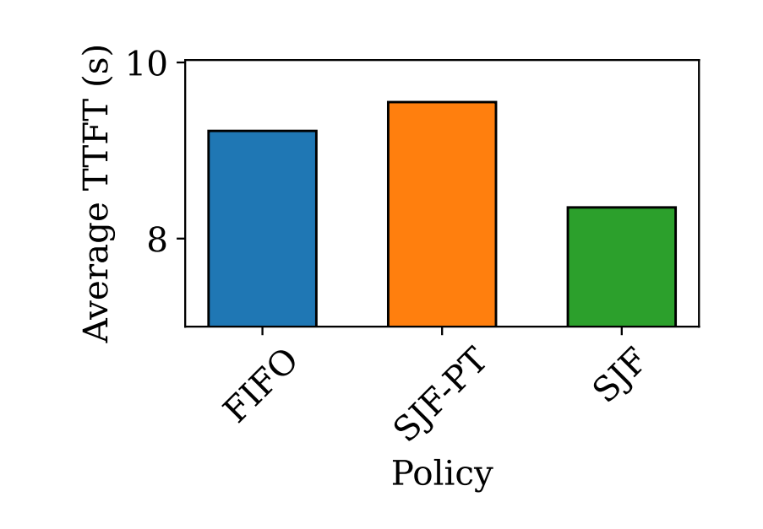
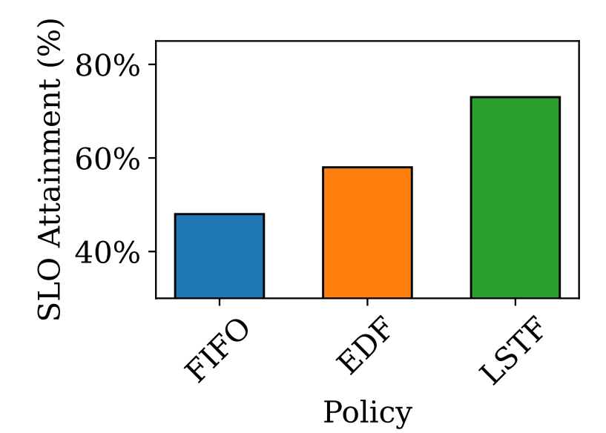
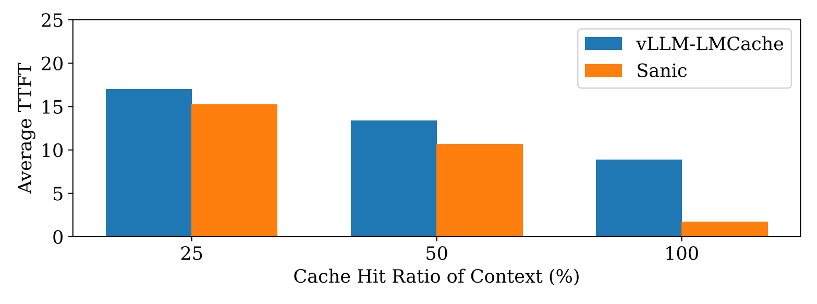
Evaluation: Micro-benchmark Analysis
Ablation Study
Sensitivity analysis
Average TTFT
Under Diverse Cache Hit Ratio
On Average TTFT Policy
On SLO Attainment Policy
Policies blind to KVCache loading time failed.
Policies leveraging the information of network cost outperform other policies.
Sanic delivers greater performance gains as the KVCache hit ratio increases.

Slide 18
Summary
Trend of network-intensive inference:
  Long-context workloads increasingly reuse large contexts with short queries.
  Inter-node KVCache reuse introduces new bottlenecks.
Problems:
  Low loading concurrency by centralized control model.
  Low scheduling quality by blindness to network cost.
Contributions:
  Stage-autonomous execution.
  Network-cost-aware scheduling.
Future work:
  Fine-grained operator-level KVCache loading pipeline optimization.
  Network-cost-aware inter-instance request dispatching optimization.
Thank you!
Email: weiyewang@sjtu.edu.cn

